Slide 1
Mildura
Special Use Zone 8 & 9 Review
Notes:
Title Slide: Click Title and Sub Title to add project information

Slide 2
Location
Notes:
Double Image Slide: Click each box to add an image

Slide 3
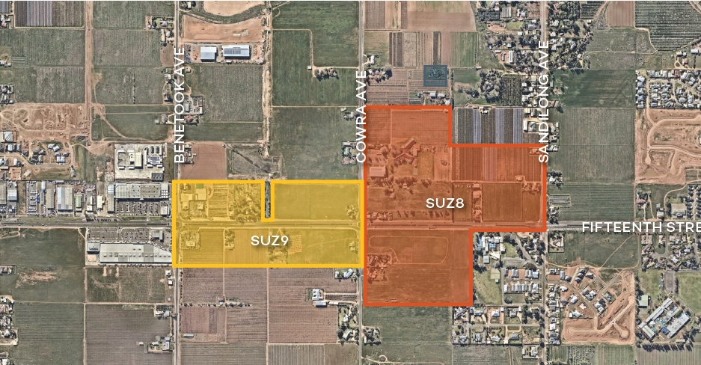
Zone Plan
SUZ8 & DDO11
SUZ9 & DDO10
Notes:
Double Image Slide: Click each box to add an image

Slide 4
Special Use Zone 8 & DD0 11 – What Does It Do?
Encourages community uses (schools, child care, place of assembly etc)
Larger lots with large setbacks
A low density “semi rural” separation between Mildura and Irymple
A gateway to Mildura
Notes:
Double Image Slide: Click each box to add an image

Slide 5
Special Use Zone 9 & DD0 10 – What Does It Do?
Encourages commercial and industrial uses
Has enhanced setbacks to commercially zoned land
A gateway to Mildura
Notes:
Double Image Slide: Click each box to add an image

Slide 6
Why Were The Zones Introduced?
To create a separation between Mildura’s and Irymple (strong support from the Irymple community).
Land had generally ceased to be used for agriculture
Accept that the land is not part of the urban area
Notes:
Double Image Slide: Click each box to add an image

Slide 7
Supported by Extensive Background Investigation
Notes:
Double Image Slide: Click each box to add an image

Slide 8
Growing Mildura
Current population of 53,878 (32,730 in Mildura City)
2,031 forecast to grow to 61,569
A growth of approximately 8,000
Notes:
Double Image Slide: Click each box to add an image

Slide 9
Planning Policy & Studies
Notes:
Double Image Slide: Click each box to add an image

Slide 10
Planning Policy & Studies
Notes:
Double Image Slide: Click each box to add an image

Slide 11
Mildura Housing Strategy
Notes:
Double Image Slide: Click each box to add an image

Slide 12
Strategy for Mildura
Mildura South a priority Growth Area
Longer term – Mildura east
Notes:
Double Image Slide: Click each box to add an image

Slide 13
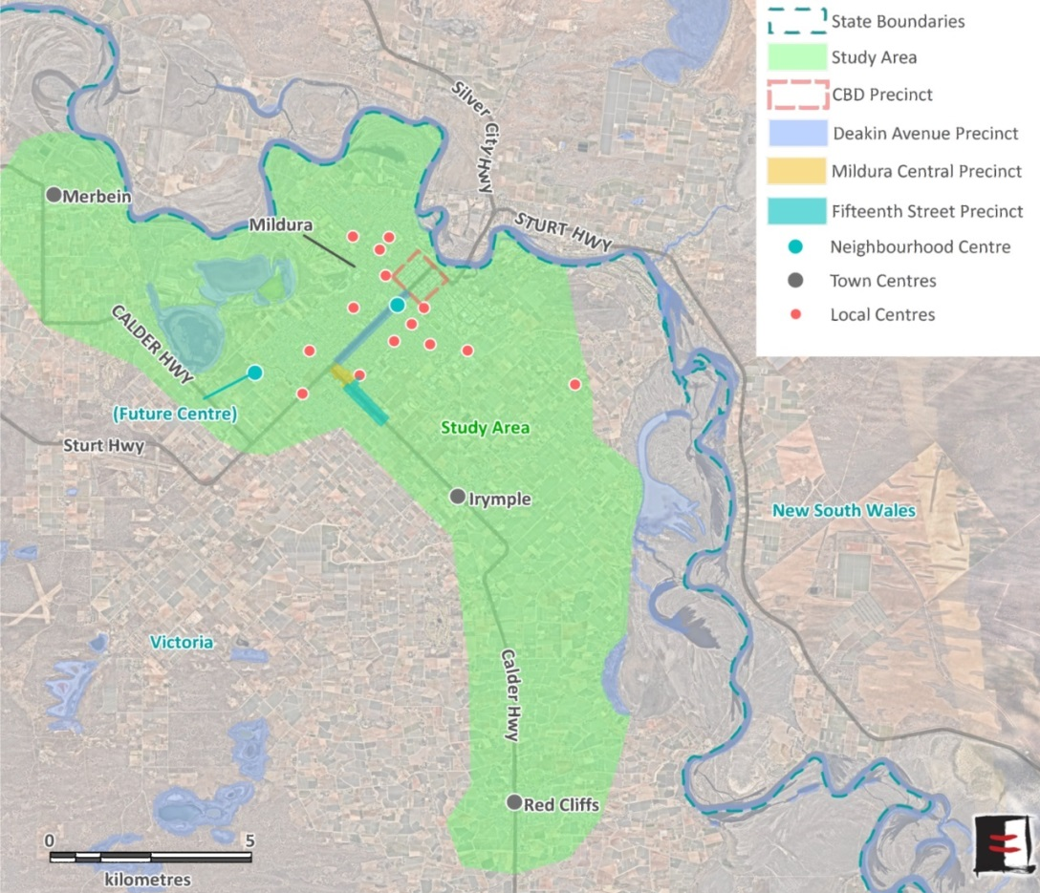
Mildura Retail Strategy Review - Overview
Essential Economics and Tract engaged to review the existing Mildura Retail Strategy (2010)
Strategy addresses issues and opportunities for all centres in the Mildura region
Background research has been undertaken and Draft Background Report is being finalised
Background Report assesses future retail demand and identifies ‘key considerations’ for the Retail Strategy Review
Background Report provides input to the SUZ Review, including demand for large format retailing and the implications for SUZ9
Notes:
Double Image Slide: Click each box to add an image

Slide 14
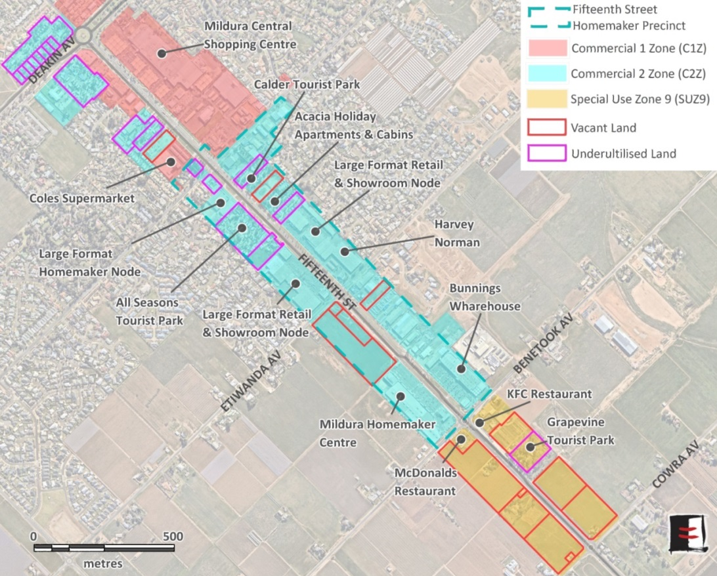
Implications for SUZ Review
From a retail perspective, SUZ9 is the most relevant:
“To develop Fifteenth Street with smaller scale restricted retail and associated business services within a landscaped setting, well setback from the road.” (Mildura Planning Scheme)
Fifteenth Street is the main location for ‘homemaker’ retailing in Mildura (56% of all homemaker floorspace in the study area.)
Fifteenth Street currently accounts for 41,120m² of non-food retail floorspace (36% of all non-food retail floorspace)
Opportunities for homemaker development exist in C2Z and SUZ9 land
Notes:
Double Image Slide: Click each box to add an image

Slide 15
Implications for SUZ Review
Implications for SUZ Review (continued)
Prudent to plan for around 4ha of land for homemaker-type retail development over the period to 2035, assuming:
Fifteenth Street accounts for 40% of future demand in ‘non-food’ retail floorspace in the region (25,200m²)
Plus 25% for non-retail uses (e.g. trade supplies)
Total demand for 13,500m² of floorspace in homemaker precincts
35-40% development efficiency
Also need to plan for other uses typically provided in C2Z land (e.g. car yards, agricultural supplies). Previous Strategy allowed for 5ha.
Therefore, total demand for C2Z-type land in the order of 9ha.
Implications:
Vacant C2Z land (5.1ha) sufficient to accommodate ‘homemaker-type’ development; however, the majority of this is within one ownership
Require either ‘under-developed’ land or SUZ9 land to accommodate other C2Z-type uses, or to provide flexibility for longer-term planning
Notes:
Double Image Slide: Click each box to add an image

Slide 16
Mildura Retail Review– Implication to Date
Envisages no significant change in demand for commercial development in the 2 zones
No strong drivers to rezone SUZ 9
A need to address temporary accommodation (observation)
Notes:
Double Image Slide: Click each box to add an image

Slide 17
Public Acquisition Overlay (PAO)
Notes:
Double Image Slide: Click each box to add an image

Slide 18
Special Use Zone 8
No strong demand for development
Significant restrictions imposed on land use
Part of a future growth area long term
Notes:
Double Image Slide: Click each box to add an image

Slide 19
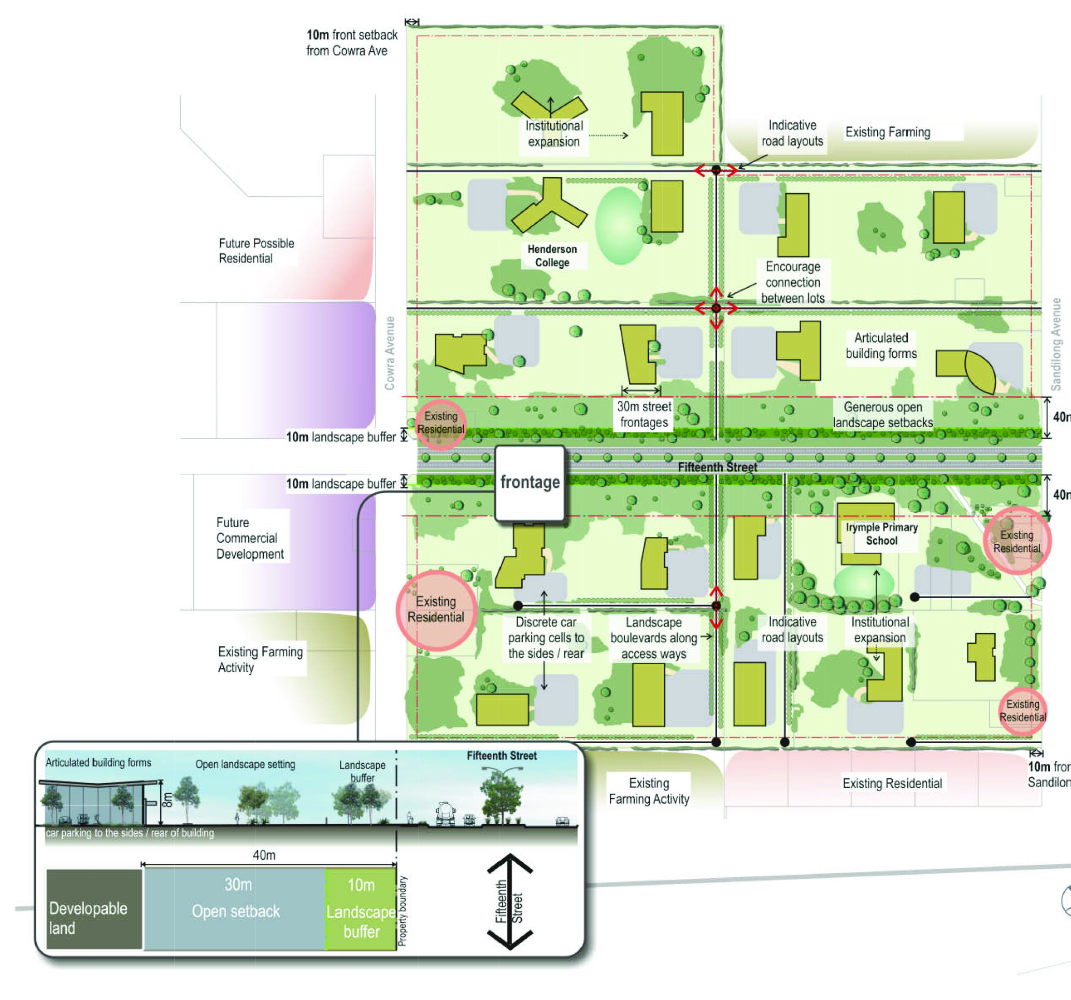
Design & Development Overlay 11
Significant setbacks reflect the urban – rural interface
Significant landscape requirements
Notes:
Double Image Slide: Click each box to add an image

Slide 20
Special Use Zone 9 & DDO10
Essentially a commercial zone
Minimal take up by new development
Less attractive to commercial and industrial development than other locations
Linked to Mildura east and future growth
Setback requirements more restrictive than other commercial areas
Landscaping more consistent with other commercial areas
Notes:
Double Image Slide: Click each box to add an image

Slide 21
General Observations
Both zones are not typical urban nor rural in the provisions and setbacks required
Both form part of what is now a potential growth area
There are different setback requirements for each zone in response to the uses encouraged
Notes:
Double Image Slide: Click each box to add an image

Slide 22
Feedback
What role might these two locations play in future growth?
What new development opportunities might exist for the zones?
How should the ‘gateway’ treatment be addressed?
How do the two zones integrate with planning for a future growth front in Mildura’s east?
Should the zones seek to preserve options for integration into a future growth areas?
Notes:
Double Image Slide: Click each box to add an image

